Slide 1


Militarium
M!M
Team: Mechs in Marketing
Abdalsalam Fadeel
Vijay Kiran Yellamraju
Hongtao Yu Anusha Anisetti
Instructor: Dr. Victor E. Middleton

Slide 2
Outline
Objective
features
Analyzing Competitors
Concepts
Game Components
Game Play Details
Unique Selling Points
Test Plan
Future Scope
Questions

Slide 3
Objective
Militarium development
– Where we started to Where we ended
Graphical Abstract:
What’s?
Systems Engineering
Militarium
Tools

Slide 4
Features
Fast and easy to learn and play
2 levels (easy and difficult)
Engages up to 8 players – perfect for ice breaking and parties!
Interesting Board Design
Innovative game mechanism
Language Independent – Universally played
Game play is challenging and strategic
Affordable
Ages 8+

Slide 5
Competitors
 | LUDO | CHECKERS | REVERSI | King me | Backgammon | The Doom that came to Atlantic City | Dread ball: The futuristic sports game
Maximum # of Players | 4 | 2 | 2 | 3-6 | 2 | 2-4 | 2
# of Levels in game | 1 | 1 | 1 | 1 | 1 | 1 | 1
Game time (minutes) | <120 | <60 | <60 | <30 | <30 | <45 | <90
Price ($$) | 24.96 | 14.99 | 19.99 | 9.99 | 52.99 | 57.28 | 56.85
Ages | 8+ | 6+ | 8+ | 8+ | 8+ | 6+ | 12+

Slide 6
Concepts
Concept A | Concept B | Concept C:
A four-player board game which is similar to Trouble game. 1 or 2 dice number, he/she gets to move one step backward. 3 or 4 dice number, he/she gets to move one step forward. 5 or 6 dice number, he/she gets to move two steps forward. When a player comes across a ladder, he/she can move an extra step forward. When a player enters danger block, then the player have to miss a turn. | A multi-players board game (>6 players). Instead of a square board, we will develop a circular board. two levels of difficulty. This game can be played in less than 120 minutes. | A two-player board game. The board is filled with block of letters in random order. The player has to make words out of the connecting letters. More letter words will get more points. Once the word is made, the letters are removed and the letters above will be moved into the empty spaces. This can go until the board is empty or no more words can be formed.

Slide 7
Concept Comparison
Table: Concepts A, B and C are screened to select the best fit concept

Slide 8
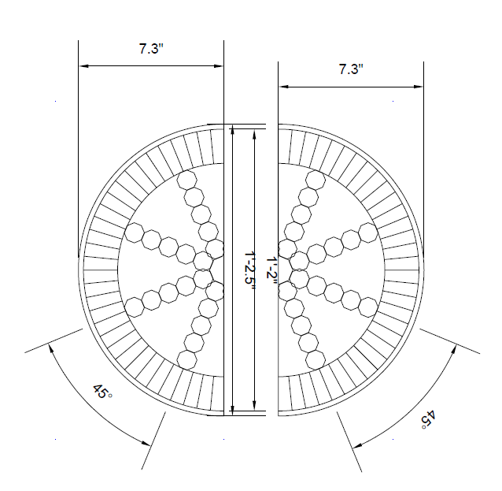
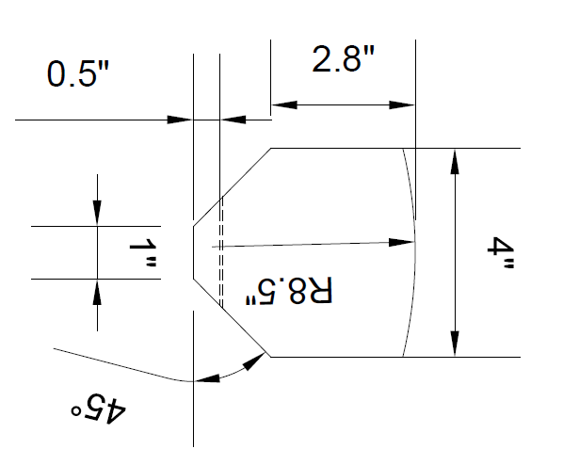
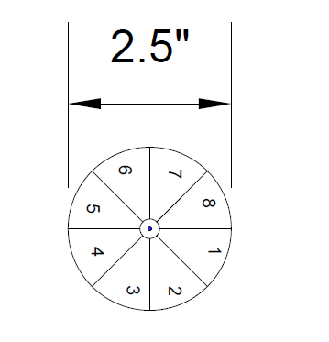
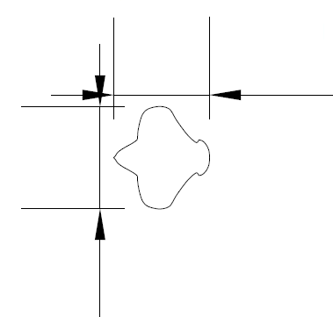
Game components - Blueprints
Main Board
Tray
Spinner
1.5”
1.6”

Slide 9
Game Components – Product Material
S.No | ITEM | Material | Blue print Status
1. | Circular Board | ABS Plastic | READY
2. | Game Layout | Gloss Paper | Ready
3. | Coins | ABS Plastic | Ready
4. | Spinner Wheel | ABS Plastic | Ready
5. | Number indicator | Gloss Paper | Ready
6. | Package Box | Hard Paper Board | Ready

Slide 10
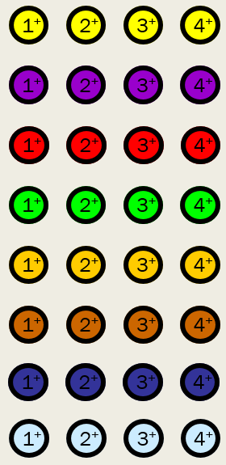
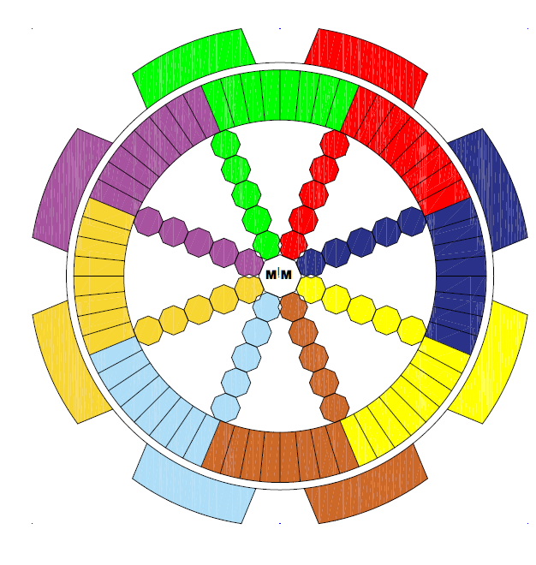

Game components
Coins
Final Main Board
Spinner Set
8
1
7
2
6
3
5
4
User Manual
Package

Slide 11
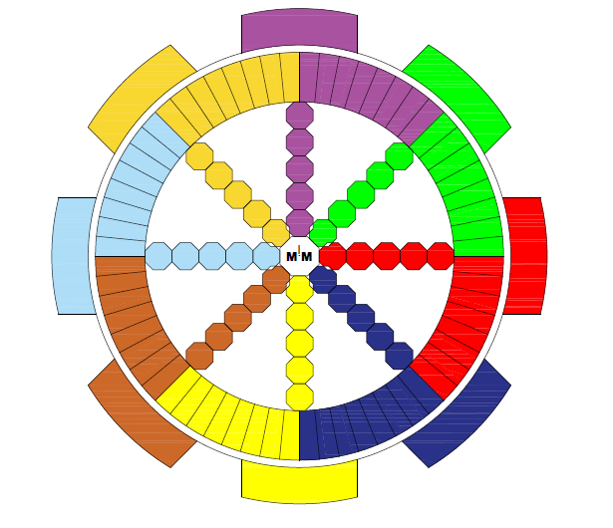
Game Play Details
Current Player
1⁺
2⁺
3⁺
4⁺
Ally
Ally
4⁺
Safe
Zone
Safe
Zone
1⁺
3⁺
2⁺
3⁺
2⁺
4⁺
1⁺
8
1
Safe
Zone
7
2
1⁺
1⁺
2⁺
2⁺
6
3
3⁺
3⁺
5
4
4⁺
4⁺
1⁺
1⁺
2⁺
2⁺
3⁺
3⁺
4⁺
4⁺
4⁺
3⁺
2⁺
1⁺

Slide 12
Game Play Details
Current Player
1⁺
2⁺
3⁺
4⁺
4⁺
Safe
Zone
Safe
Zone
1⁺
3⁺
2⁺
3⁺
2⁺
4⁺
1⁺
8
1
Safe
Zone
7
2
1⁺
1⁺
2⁺
2⁺
6
3
3⁺
3⁺
5
4
4⁺
4⁺
1⁺
1⁺
2⁺
2⁺
3⁺
3⁺
4⁺
4⁺
4⁺
3⁺
2⁺
1⁺

Slide 13
Game Play Details:
Current Player
2⁺
3⁺
4⁺
4⁺
Safe
Zone
1⁺
Safe
Zone
1⁺
3⁺
2⁺
3⁺
2⁺
4⁺
1⁺
8
1
Safe
Zone
7
2
1⁺
1⁺
2⁺
2⁺
6
3
3⁺
3⁺
5
4
4⁺
4⁺
1⁺
1⁺
2⁺
2⁺
3⁺
3⁺
4⁺
4⁺
4⁺
3⁺
2⁺
1⁺

Slide 14
Game Play Details:
Current Player
2⁺
3⁺
4⁺
4⁺
Safe
Zone
Safe
Zone
1⁺
3⁺
2⁺
3⁺
2⁺
4⁺
1⁺
1⁺
8
1
Safe
Zone
7
2
1⁺
1⁺
2⁺
2⁺
6
3
3⁺
3⁺
5
4
4⁺
4⁺
1⁺
1⁺
2⁺
2⁺
3⁺
3⁺
4⁺
4⁺
4⁺
3⁺
2⁺
1⁺

Slide 15
Game Play Details
Current Player
2⁺
3⁺
4⁺
4⁺
Safe
Zone
Safe
Zone
1⁺
3⁺
2⁺
3⁺
2⁺
4⁺
1⁺
8
1
Safe
Zone
7
2
1⁺
1⁺
2⁺
2⁺
6
3
3⁺
1⁺
3⁺
5
4
4⁺
4⁺
1⁺
1⁺
2⁺
2⁺
3⁺
3⁺
4⁺
4⁺
4⁺
3⁺
2⁺
1⁺

Slide 16
Game Play Details:
2⁺
4⁺
4⁺
Safe
Zone
3⁺
Safe
Zone
1⁺
3⁺
2⁺
3⁺
2⁺
4⁺
1⁺
8
1
Safe
Zone
7
2
1⁺
1⁺
2⁺
2⁺
6
3
3⁺
1⁺
3⁺
5
4
4⁺
4⁺
Current Player
1⁺
1⁺
2⁺
2⁺
Red’s score = 3+1 =4
3⁺
3⁺
4⁺
4⁺
4⁺
3⁺
2⁺
1⁺

Slide 17
Game Play Details
2⁺
4⁺
4⁺
Safe
Zone
3⁺
Safe
Zone
1⁺
3⁺
2⁺
3⁺
2⁺
4⁺
1⁺
8
1
Safe
Zone
7
2
1⁺
1⁺
2⁺
2⁺
6
3
3⁺
3⁺
5
4
4⁺
1⁺
4⁺
Current Player
1⁺
1⁺
2⁺
2⁺
3⁺
3⁺
4⁺
4⁺
4⁺
3⁺
2⁺
1⁺

Slide 18
Game Play Details
Current Player
2⁺
4⁺
4⁺
Safe
Zone
3⁺
Safe
Zone
1⁺
3⁺
2⁺
3⁺
2⁺
4⁺
1⁺
8
1
Safe
Zone
7
2
1⁺
1⁺
2⁺
1⁺
2⁺
6
3
3⁺
3⁺
5
4
4⁺
4⁺
1⁺
1⁺
2⁺
2⁺
3⁺
3⁺
4⁺
4⁺
4⁺
3⁺
2⁺
1⁺

Slide 19
Unique value
 | LUDO | CHECKERS | REVERSI | MILITARIUM
Maximum # of Players | 4 | 2 | 2 | 2,4,6, or 8
Number of Levels in game | 1 | 1 | 1 | 2
Game time | <120 minutes | <60 minutes | <60 minutes | Easy level < 60 minutes Difficult level <120 minutes
Durability | Wearing issues | Wearing issues | Wearing issues | Unique board design to avoid wearing
Price | $24.96 | $14.99 | $19.99 | $15.99
Game Mechanism | Dice rolling | Dice rolling | None | Spinner
User friendly rules | No | No | No | Yes

Slide 20
Target market
Primary:
Ages 8+
Family and party games
Marketing plan
Developing a website
Customer support
Visual exposure -
Electronic promotions
M!M

Slide 21
Future Scope
Game can be developed in electronic format
Game layout can be modified with themes (movie references, sports etc.)
Market globally
Introduce more difficulty levels
Introduce more rules
Design modifications:
Add gripping pin to the spinner for easy spinning
Adapt new game component materials for easy manufacturing
Different joint mechanisms for better durability

Slide 22
Thank You
for
Your Attention

